Slide 1
Black Box Testing: Equivalence Partitioning, Boundary Value Analysis, Use Case Testing
420-E31 Systems III
Reference:
Ron Patton. Software Testing. Second Edition. 2006
Bernard Holmes. Fundamentals of Software Testing. 2012

Slide 2
Review: Static and Dynamic Testing
Static Testing
Testing something that is not running by examining and reviewing it.
Examples: Code inspections
Dynamic Testing
Testing software by running and using it.
Notes:
Analogy – buying used car. Static – kicking tires, looking under hood. Dynamic – test drive

Slide 3
Review: Black Box Testing
Tester knows what software is supposed to do, but cannot look in it (the box) to see how it operates.
Notes:
Risk – easy to become biased because tests may be tailored to match code’s operation

Slide 4
Review: White Box Testing
Tester has access to the code and can examine it for clues to help with the testing.
Tester may determine that certain conditions are more or less likely to fail and tailor testing based on that.
Notes:
Risk – easy to become biased because tests may be tailored to match code’s operation

Slide 5
Static Black Box Testing
Testing the specification
Perform a high-level review of the Specification
Pretend to be the customer
Research existing standards and guidelines
Review and test similar software
Notes:
Can be tested no matter what the format. Even if unwritten, can question analysts and designers
Perform a high-level review of the Specification
Examine the spec for large fundamental problems, oversights, omissions
Pretend to be the customer
Do research about who the customers will be and understand expectations
If spec is unclear, don’t assume it’s correct
Research existing standards and guidelines
Standard – must be strictly adhered to
Guideline – optional, but should still be followed
Examples of standards and guidelines:
Corporate terminology and conventions, e.g. Heritage standards
Industry requirements, e.g. medical, financial, etc.
Government standards, e.g. common look and feel
Graphical User Interface, e.g. Windows or Macintosh standards
Tester’s job is to consider standards as part of the specification
Review and Test Similar Software

Slide 6
Dynamic Black Box Testing
Testing the Software
No details of underlying code
Focuses on how well a program meets the functional requirements of the system
Need some definition of what software does
Exploratory testing if no specification is available
Notes:
Testing software without having an insight into the details of underlying code
Dynamic because program is running.
Black-Box because tester does not know how it works.
Black box testing focuses on functional testing, which tests how well a program meets the functionality requirements of the system. Tests sets are derived to fully exercise all functional requirements.
Requires some definition of what software does – requirements document or product specification.
Exploratory Testing – if no spec is available
Process of methodically exploring the software feature by feature

Slide 7
Dynamic Black Box Testing Methodology
The derivation of test inputs is based on program specifications
Clues are obtained from the specifications
Clues lead to test requirements
Test requirements lead to test specifications
Test specifications are then used to actually execute the program under test
Notes:
Two types of pre-conditions are considered:
Validated: those that are required to be validated by the program under test and an error action is required to be performed if the condition is not true.
N>0
On failure return -1; sorting considered unsuccessful
Assumed: those that are assumed to be true and not checked by the program under test
The input sequence contains N integers.
The output area has space for at least N integers.

Slide 8
Black Box Test Strategies
We are going to look at 3 black box testing strategies:
Equivalence Partitioning
Boundary Value Analysis
Use Case Testing

Slide 9
Test Case – Definition
Set of test inputs, execution conditions, and expected results developed for a particular objective.
Meant to exercise a particular program path or to verify compliance of a specific requirement.

Slide 10
Categorizing Test Cases
Categorized by type of test or requirement they are associated with
Positive path
Need a test case to demonstrate the requirement has been achieved
Negative path
Need test case(s), reflecting an unacceptable, abnormal, or unexpected condition or data, to demonstrate that the requirement is only achieved under the desired condition
Notes:
Positive test and negative test

Slide 11

Interaction
A farming sorter:
Camera scans items on a conveyer belt and outputs what kind of fruit they are.
What are some positive path vs negative path test cases?

Slide 12
Equivalence Partitioning

Slide 13
Equivalence Partitioning
The input domain is usually too large for exhaustive testing
It is partitioned into a finite number of sub-domains or sets for the selection of test inputs
Each sub-domain is known as an equivalence class and serves as a source of at least one test input

Slide 14
Non-Overlapping Partitions
An equivalence class is considered covered when at least one test has been selected from it.
In partitioning, goal is to cover all equivalence classes.
Notes:
In partition testingAn equivalence class is considered covered when at least one test has been selected from it.
our goal is to cover all equivalence classes.
Example 2:
Suppose that program P takes three integers X, Y and Z. It is known that:
X<Y
Z>Y

Slide 15
Equivalence Partition
Set of test cases that tests the same thing or reveals the same bug. Program behaves in an equivalent way for all the test cases in the equivalence partition.
Also called equivalence class
Notes:
For example numbers:
Integers, positive, negative
Real numbers (i.e. floating point), really tiny numbers, really large numbers
Zero

Slide 16
Types of Equivalence Partitions
Valid equivalence partitions or classes – describe partitions containing values that are valid input
Invalid equivalence partitions or classes – describe partitions containing values that are invalid input

Slide 17
Equivalence Class Guideline: Range
If an input condition specifies a range, one valid and two invalid equivalence classes are defined.
Within the range is valid
Too large or too small are invalid
Example: Age is a number from 1 - 99.
Valid equivalence class: [1 – 99]
Invalid equivalence class: [less than one]
Invalid equivalence class: [greater than 99]

Slide 18
Equivalence Class Guideline: Value
Input condition specifies a value: create one for the valid value and two for incorrect values (below and above the valid value)
Example: PIN must be 4 digits
Valid – 4 digit number: 1234
Invalid – less than 4 or greater than 4: 123 or 12345
Notes:
If input condition specifies a range, define equivalence classes as follows: (e.g. year between 1902 and 2010)
1 valid - within range (1999)
2 invalid - above range and below range (1900, 2100)
If input condition specifies a specific value, define equivalence classes as follows: (e.g. PIN must be 4 digits)
1 valid – 4 digit number (1234)
2 invalid – below specific value, above specific value (3 digits, 5 digits)

Slide 19
Equivalence Class Guideline: Set
Input condition specifies a member of a set: create one for each valid value and one for the invalid (not in the set) value
Example: Frequency must be daily, weekly, or monthly
Valid – one for each member of the set: daily, weekly, monthly
Invalid – for non-member of set: annually
Notes:
If input condition specifies a member of a set, define equivalence classes as follows: (e.g. daily, quarterly, monthly)
1 valid - for each member of set: daily, weekly, monthly
1 invalid - for non-member of set: annually
If input condition is Boolean, define equivalence classes as follows: (e.g. password is required)
1 valid – condition met (password entered)
1 invalid – condition not met (password not entered)
In the previous examples we derived equivalence classes based on the conditions satisfied by the input data.
Then we selected just enough tests to cover each partition.

Slide 20
Equivalence Class Guideline: Boolean
If input condition is Boolean, create one for the valid value (condition met) and one for invalid (condition not met) value
Example: Password must be entered
Valid – condition met: password entered
Invalid – condition not met: password not entered
Notes:
If input condition specifies a member of a set, define equivalence classes as follows: (e.g. daily, quarterly, monthly)
1 valid - for each member of set: daily, weekly, monthly
1 invalid - for non-member of set: annually
If input condition is Boolean, define equivalence classes as follows: (e.g. password is required)
1 valid – condition met (password entered)
1 invalid – condition not met (password not entered)
In the previous examples we derived equivalence classes based on the conditions satisfied by the input data.
Then we selected just enough tests to cover each partition.

Slide 21
Sufficiency of Partitions
Derive equivalence classes based on the conditions satisfied by the input data
Select just enough tests to cover each partition.
Notes:
If input condition specifies a member of a set, define equivalence classes as follows: (e.g. daily, quarterly, monthly)
1 valid - for each member of set: daily, weekly, monthly
1 invalid - for non-member of set: annually
If input condition is Boolean, define equivalence classes as follows: (e.g. password is required)
1 valid – condition met (password entered)
1 invalid – condition not met (password not entered)
In the previous examples we derived equivalence classes based on the conditions satisfied by the input data.
Then we selected just enough tests to cover each partition.

Slide 22
Interaction
A legal password
Begins with A-Z
Contains A-Z, 0-9
Has 1-6 characters
What are the equivalence classes?
What are the test cases?

Slide 23
Equivalence Classes
Specification Condition | Valid Equivalence Classes | Invalid Equivalence Class
Starting character | 1. Starts A-Z | 2. Starts Other
Characters | 3. A-Z, 0-9 | 4. Has Others
Length | 5. 1-6 characters | 6. 0 7. > 6 characters
Notes:
Test Cases:
AB36P - 1, 3, 5
1XY12 - 2
A17#%X – 4
- 6
VERYLONG – 7

Slide 24
Create Test Cases
Add a new test case until all valid equivalence classes have been covered. A test case can cover multiple such classes.
Add a new test case until all invalid equivalence classes have been covered. Each test case can cover only one such class.
Test Cases:
AB36P - 1, 3, 5
1XY12 - 2
A17#%X – 4
- 6
VERYLONG – 7

Slide 25
Boundary value analysis

Slide 26
Boundary Value Analysis (BVA)
Another way to generate test cases is to look for boundary values
Complements equivalence partitioning.
Leads to selection of test cases at the “edges” of the class.
Derives test cases from the output domain as well.

Slide 27
Types of Defects Found by BVA
Incorrect use of relational operators (<, >, <=, >=, =, !=)
Off by one errors on limits
Problems in loops and iterations

Slide 28
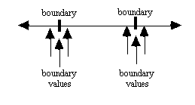
Guidelines for BVA
Similar to equivalence partitioning
If input condition specifies a range bounded by values a and b, test cases should be designed with values a and b and just above and just below a and b.

Slide 29
Guidelines for BVA
If input condition specifies a number of values, test cases should be designed to exercise minimum and maximum numbers as well as values just above and below minimum and maximum.

Slide 30
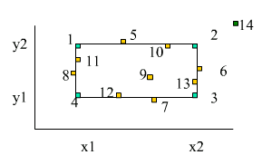
Boundary Value Analysis (BVA)
Suppose a program takes two integers X and Y and that they are both within ranges: x1<=X<x2 and y1<=Y<=y2

Slide 31
Boundary Value Analysis (BVA)
In this case, the four sides of the rectangle represent the boundary.
The heuristic for test selection in this case is:
Select one test case at each corner (1, 2, 3, 4)
Select one test case just outside each of the four sides of the boundary (5, 6, 7, 8)
Select on test case just inside each of the fours sides of the boundary (10, 11, 12, 14)
Select one test case inside the bounded region (9)
Select one test case outside the bounded region (14)

Slide 32
Interaction
BVA can be done on any type of data.
Suppose a program takes a string S and an integer X as inputs. The constraints on inputs are: length(s) <= 100 and a<=X<=b.
Determine the test cases using BVA.

Slide 33
Boundary Value Analysis (BVA)
BVA can be applied to output data.
Doing so gives equivalence classes for the output domain.
Then try to find test inputs that will cover each output equivalence class.

Slide 34
Use case testing

Slide 35
Test Cases from Use Cases
Test cases should be developed for each use-case scenario
Identified by describing the paths through the use case that traverse the basic flow and alternate flows start to finish through the use case

Slide 36
Use Case Scenario
Basic flow
The straight, black-line is the most common path through the use case
Alternate flows
Begins with the basic flow and then, dependent upon a specific condition, the alternate flow is executed
May rejoin the basic flow
May originate from another alternate flow
May terminate the use case without rejoining a flow

Slide 37
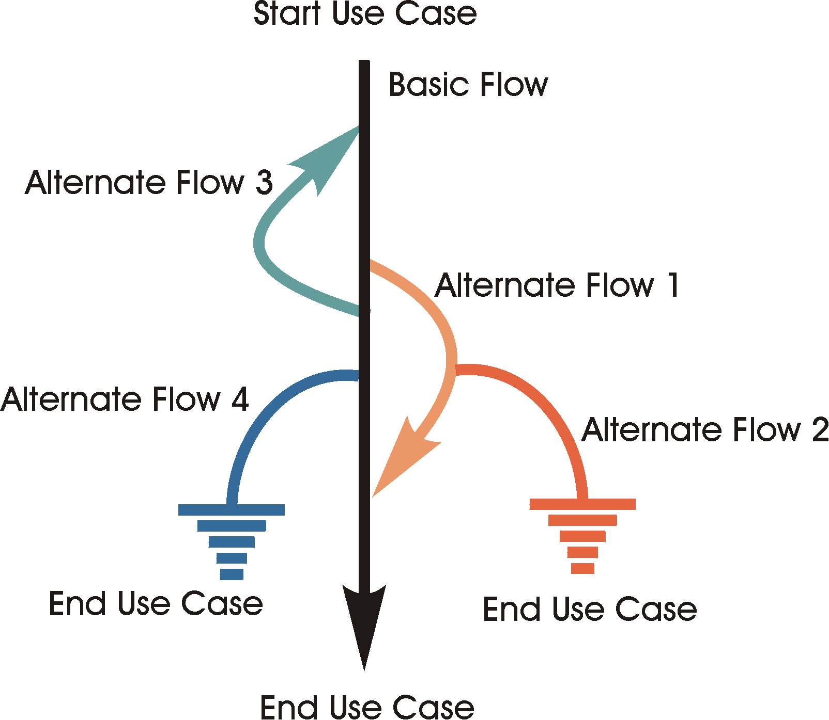
Use Case Flow

Slide 38
How to Create Test Cases from Use Cases
Begin with the basic flow and then combine the basic flow with alternate flows to define the use case scenarios.

Slide 39
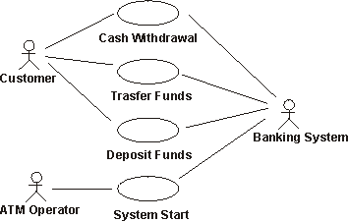
ATM Use Case Example

Slide 40
Use Case Scenarios
Scenario 1 | Basic Flow
Scenario 2 | Basic Flow | Alternate Flow 1
Scenario 3 | Basic Flow | Alternate Flow 1 | Alternate Flow 2
Scenario 4 | Basic Flow | Alternate Flow 3
Scenario 5 | Basic Flow | Alternate Flow 3 | Alternate Flow 1
Scenario 6 | Basic Flow | Alternate Flow 3 | Alternate Flow 1 | Alternate Flow 2
Scenario 7 | Basic Flow | Alternate Flow 4
Scenario 8 | Basic Flow | Alternate Flow 3 | Alternate Flow 4
NOTE: For simplicity, Scenarios 5, 6, and 8 only depict a single execution of the loop indicated by Alternate flow 3.
Notes:
NOTE: For simplicity, Scenarios 5, 6, and 8 only depict a single execution of the loop indicated by Alternate flow 3.

Slide 41
Derive Test Cases
Identify the specific condition that will cause that specific use-case scenario to be executed
For example, suppose the use case depicted in the diagram above stated the following for Alternate Flow 3:

Slide 42
Alternate Flow 3
"This flow of events occurs if the dollar amount entered in Step 2 above, "Enter Withdraw Amount" is greater than the current account balance.
The system displays a warning message and then rejoins the basic flow at Step 2 "Enter Withdraw Amount" above, where the bank customer can enter a new withdrawal amount."

Slide 43
Simplified Example
Test Case ID | Scenario | Condition | Expected Result
TC x | Scenario 4 | Step 2 - Withdraw Amount > Account Balance | Rejoin basic flow at Step 2
TC y | Scenario 4 | Step 2 - Withdraw Amount < Account Balance | Does not execute Alternate Flow 3, takes basic flow
TC z | Scenario 4 | Step 2 - Withdraw Amount = Account Balance | Does not execute Alternate Flow 3, takes basic flow

Slide 44
Use Case Example
Refer to the example given
Figure out the use case scenarios that can be derived
Make sure you read the end of the Use Case

Slide 45
Derived Scenarios
Scenario 1 - Successful cash withdraw | Basic Flow
Scenario 2 - ATM out of money | Basic Flow | Alternate Flow 2
Scenario 3 - Insufficient Funds in ATM | Basic Flow | Alternate Flow 3
Scenario 4 - Incorrect PIN (tries left) | Basic Flow | Alternate Flow 4
Scenario 5 - Incorrect PIN (no tries left) | Basic Flow | Alternate Flow 4
Scenario 6 - No Account / incorrect account type | Basic Flow | Alternate Flow 5
Scenario 7 - Insufficient Account Balance | Basic Flow | Alternate Flow 6
NOTE: For simplicity the loops in Alternate flows 3 and 6 (Scenarios 3 and 7), and combinations of loops have not been included in the table above.
Notes:
NOTE: For simplicity the loops in Alternate flows 3 and 6 (Scenarios 3 and 7), and combinations of loops have not been included in the table above.

Slide 46
Create Test Cases
Identify test cases for each of these scenarios in a matrix
Each row represent an individual test case
The columns identify test case information
For each test case, record the following:
Test case ID
Condition (or description)
All the data elements in the test case (as input or already in the database),
Expected result

Slide 47
Developing Test Case Matrix
Identify what data elements are required to execute the use-case scenarios
For each scenario, identify at least one test case that contains the appropriate condition to execute the scenario. V (valid) is used to indicate this condition must be VALID for the basic flow to execute and I (invalid) is used to indicate the condition which will invoke the desired alternate flow.
"n/a" indicates that this condition is not applicable to the test case.

Slide 48
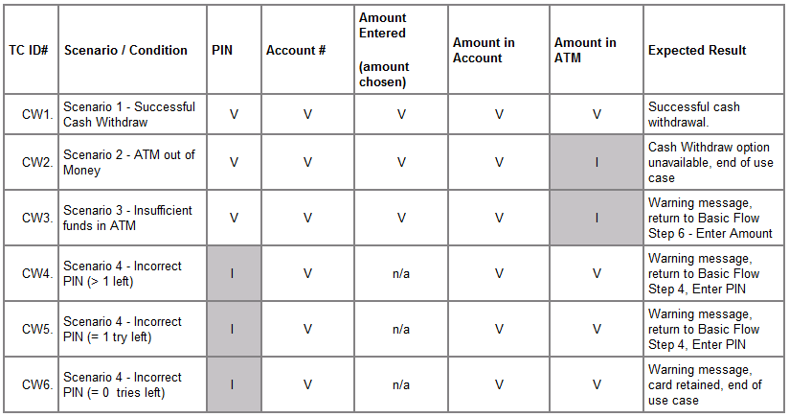
Developing Test Case Matrix

Slide 49
Looking at the Matrix
Matrix does not have values for the conditions. Advantage is that it is easy to see what conditions are being tested
Once all the test cases have been identified, need to be reviewed and validated to ensure accuracy, appropriateness, and eliminate redundant or equivalent ones
Upon approval, the actual data values can be identified and the test data built
Notes:
Looking at the above table, there are several conditions for which there is no shaded cell (no invalid conditions), therefore, we are missing test cases, such as for Scenario 6 - No Account or Incorrect Account Type and Scenario 7 - Insufficient Account Balance.

Slide 50
Use Case Testing Guidelines
Ensure that sufficient test cases, positive and negative, have been identified for each use-case scenario
Ensure that they address any business rules implemented by the use cases, ensuring that there are test cases inside, outside, and at the boundary condition / value for the business rule

Slide 51
Use Case Testing Guidelines
Ensure that they address any sequencing of events or actions, such as those identified in the sequence diagrams in the design model, or user interface object states or conditions
Ensure that they address any special requirements defined for the use case, such max/min performance, sometimes combined with max/min loads or data volumes during the execution of the use cases
Notes:
Min and max performance and load criteria

